Slide 1
Solar Power Plant Electricity Generation Analysis
Analyst: Kaival Panchal

Slide 2
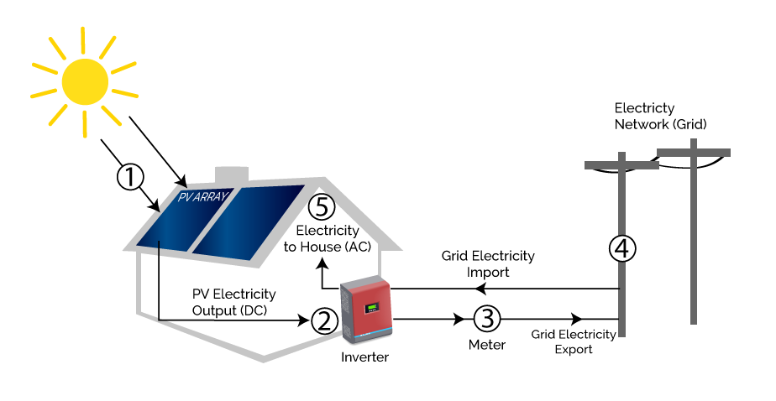
How do Solar panels work?

Slide 3


Background Information
Data had been gathered at two solar power plants in India over a 34 day period. It has two pairs of files - each pair has one power generation dataset and one sensor readings dataset. The power generation datasets are gathered at the inverter level - each inverter has multiple lines of solar panels attached to it. The sensor data is gathered at a plant level - single array of sensors optimally placed at the plant.

Slide 4
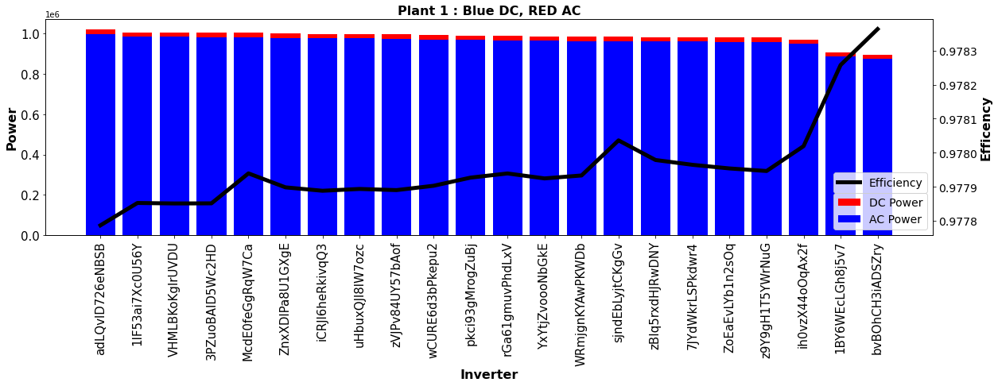
In Plant 1 - Which inverter has produced maximum DC/AC power, and how does each Inverter compare to each other?

Slide 5
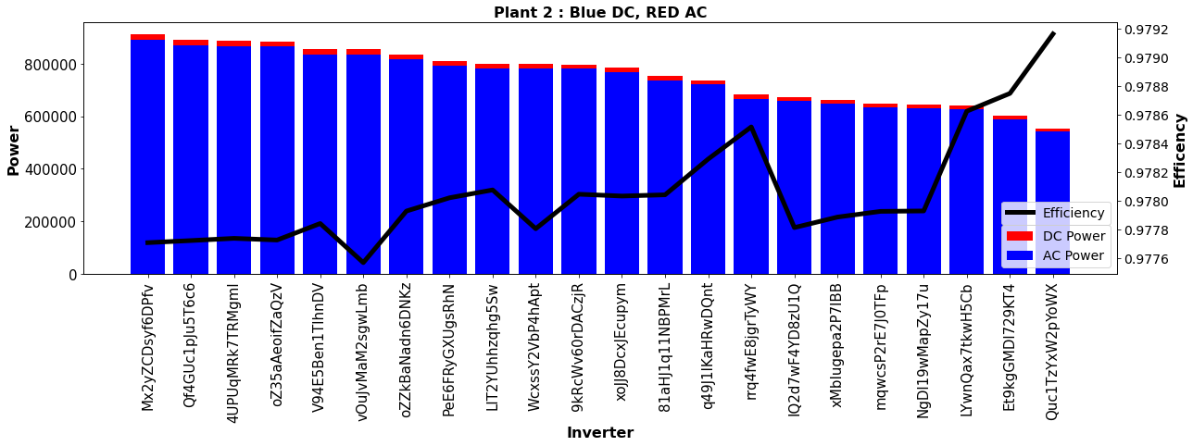
In Plant 2 - Which inverter has produced maximum DC/AC power, and how does each Inverter compare to each other?

Slide 6
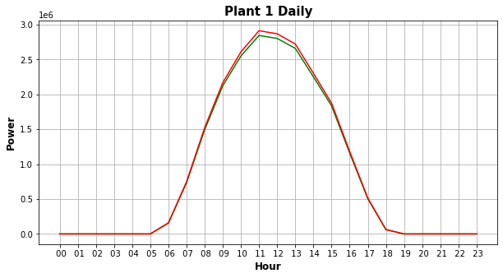
In Plant 1 What and when is the maximum/minimum amount of DC/AC Power generated in a time interval/day? How does overall distribution look?

Slide 7
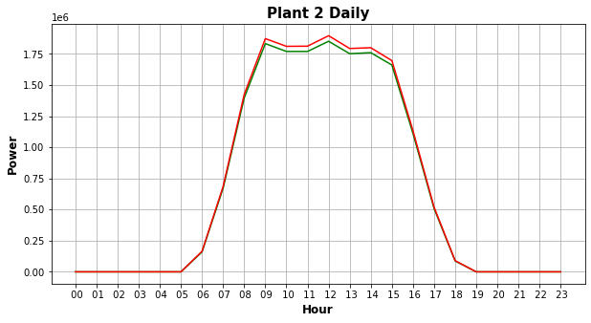
In Plant 2 What and when is the maximum/minimum amount of DC/AC Power generated in a time interval/day? How does overall distribution look?

Slide 8
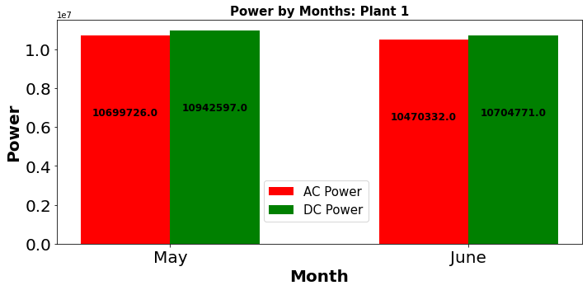
Which Month Performed the best? – Plant 1

Slide 9
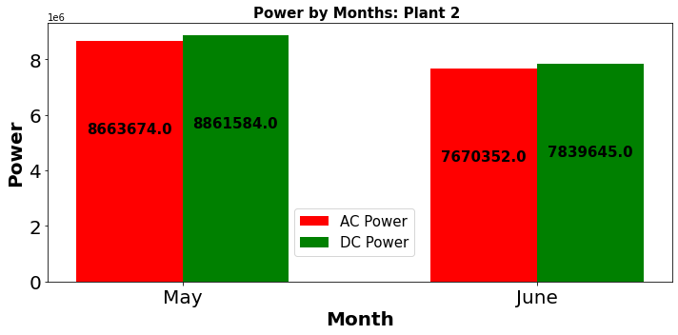
Which Month Performed the best? – Plant 2

Slide 10
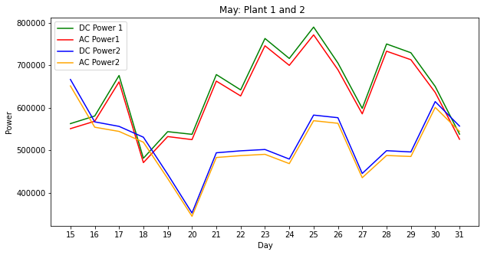
What day in May was the best in both plants?

Slide 11
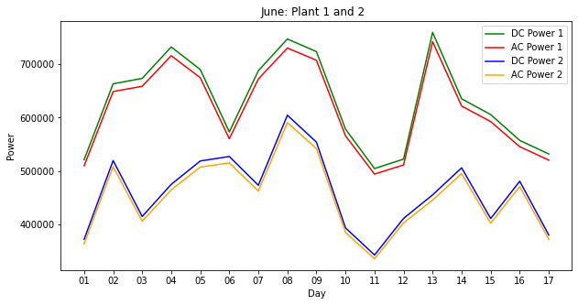
What day in June was the best in both plants?

Slide 12
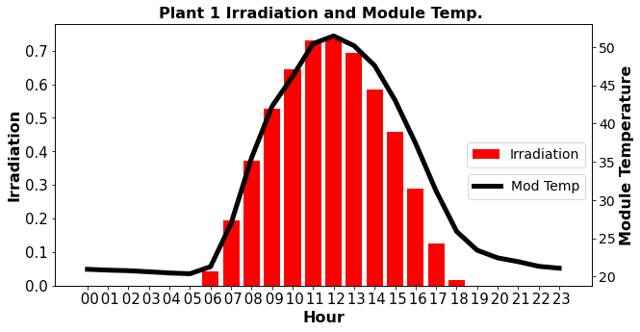
How does the distribution of irradiation and module temperature look in a day. – Plant 1

Slide 13
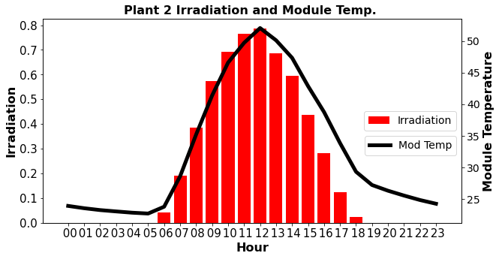
How does the distribution of irradiation and module temperature look in a day. – Plant 2

Slide 14
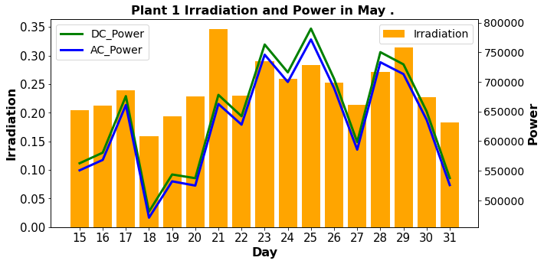
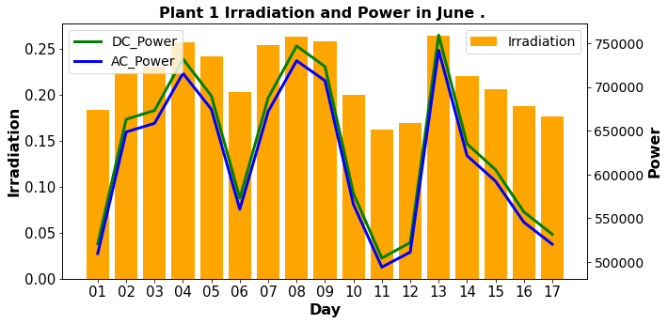
Relationships Between Irradiation and Power – Plant 1

Slide 15
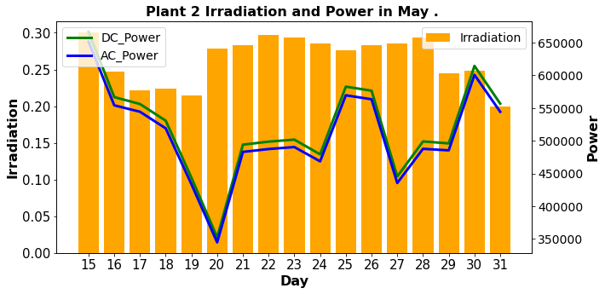
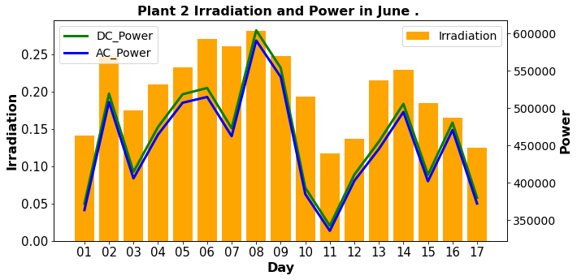
Relationships Between Irradiation and Power – Plant 2

Slide 16
Issues during analysis…
Based on efficiency Calculation above, Plant 1's max efficiency was only 10% meaning that only 10% of the DC power obtained from the sun is being transferred to AC power.
However, if we assume that there is a problem with the sensor collecting Plant 1's DC Power data, upon looking at the data, seems like the DC Power of Plant 1 is off by a factor of 10.
After the factor fix, the average efficacy of both plants operate around 97% and the 3% can be attributed to the powering of the inverters and heat.
However, if found that the sensors are working correctly there must be some issue in plant 1 as the conversion of DC to AC is not efficient whatsoever. Maintenance of the Inverters are needed, and some Monitoring process should be in place to ensure the efficiency does not drop lower than a certain threshold i.e 95%

Slide 17
Thank You

